Slide 1

Multilingual Dialogue Summary Generation System for Customer Service
Tharindu De Silva w1761890 | 2018367
Supervised by
Ms. Dileeka Alwis

Slide 2
Agenda
Problem Background
Research Gap
Aim of the Project
System Design
Proposed Approach
Implementation
Demo
Testing and Evaluation
Limitation and Enhancement
Conclusion

Slide 3
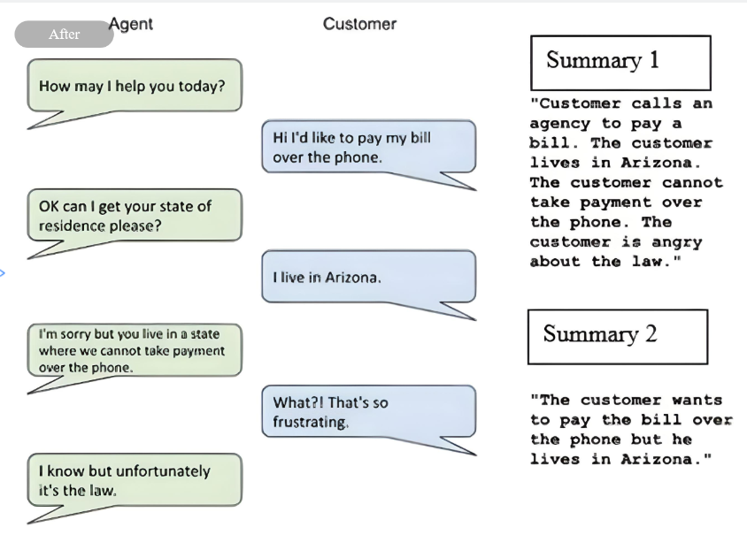
What is Dialogue Summarization ?
Notes:
A written or spoken conversation between two or more people is called a dialogue. Dialogue summarization is the technique of generating a short description about the context of a dialogue so that a reader can quickly understand the context without going through entire dialog. The dialogue summarization method involves extracting important information by highlighting the conversation's main points. With the development of communication technology in recent years, dialogues have become an important way of information exchange.

Slide 4
Problem Domain

Slide 5



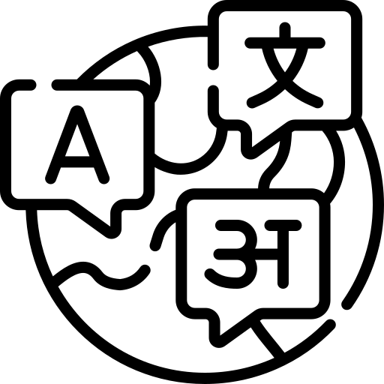

Problem Background
Customer-Support Service
Conversation between customer and support agent
Support agent writing a summary
Customer service supporting many languages
Current solution limited for one language
Notes:
So the problem is in the customer service domain the conversation between customer and the support agent generates lot of text data. So at the end of the conversation support agents are asked to write a short summary of the conversation for later reference or for various purposes. So sometimes these dialogues can be very lengthy even it is challenging for a human to summarize. With the globlization languages are not only limited to english. But with the limited amount of solutions it is not convenient for end users to utilize these solution.

Slide 6
Problem Statement
The lack of automated dialogue summarization solutions capable of handling languages other than English poses a critical challenge for global customer service, requiring human resources with linguistic fluency in multiple languages to manually summarize dialogues.

Slide 7
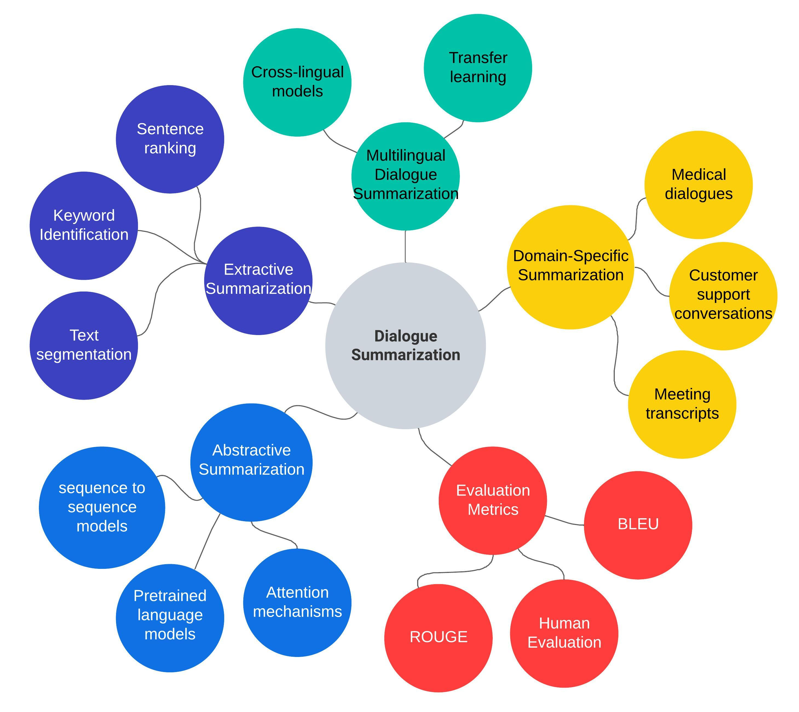
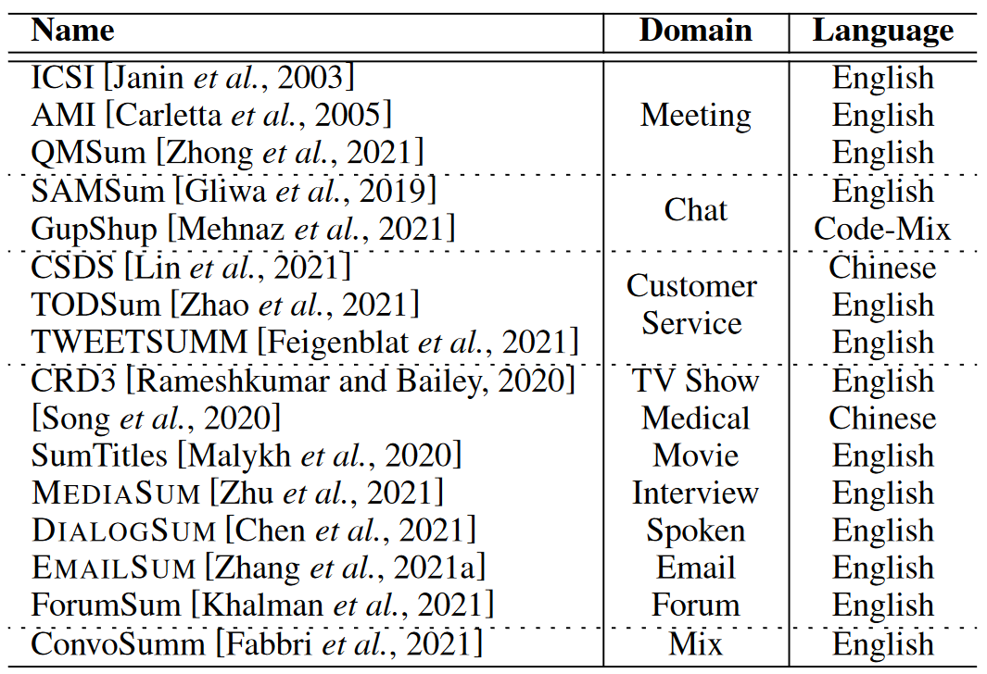
Research Gap
Heavily focused on English Language.
Limited amount of dataset availability.
(Zou et al., 2021)
Globalization leads to dialogues involving multinational participants.
Urgent need for providing dialogue summaries with preferred language. (Feng, Feng and Qin, 2022)
Notes:
Identified research gap from the papers outlined that dialogue summarization is currenlty focused on english because of the limited amount of dataset avaialbility. Also the recently published survey paper for dialogue summarization suggest developing a multilingual dialogue summarization is a future research area. If we look at the concept map these are the areas that dialogue summarization domain is spreaded. In this research project the author will try to address multilingual dialogue summarization for customer support communication.

Slide 8
Aim
The aim of this research is to design, develop and evaluate a multilingual dialogue summary generation system for customer services using dialogue summarization model with the help of the cross-lingual transfer method.
RQ1: What are the current limitations in dialogue Summarization?
RQ2: How can existing resources be utilized to develop a multilingual dialogue summarizer using cross-lingual transfer techniques?
RQ3: What are the recent advancements in pre-trained language models that can be used to build a multilingual dialogue summary generation solution?

Slide 9
Proposed Approach
Notes:
Let's have a look in the System Design. First the textual dialogue input will be going through a process for identifying its language type. Then the identified language will be set as the source language. After that the dialogues will be go through the cross-lingual transfer modal which is the m2m100 pretrained model. This model will perform a machine translation from identified source language to target English language. After the machine translation process all the dialouges data have been translated will be go through the dialogue summarization modal.

Slide 10
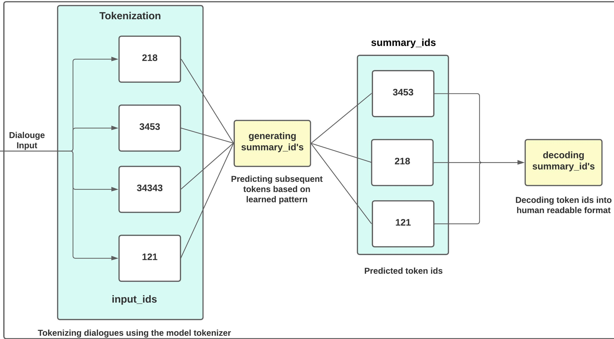
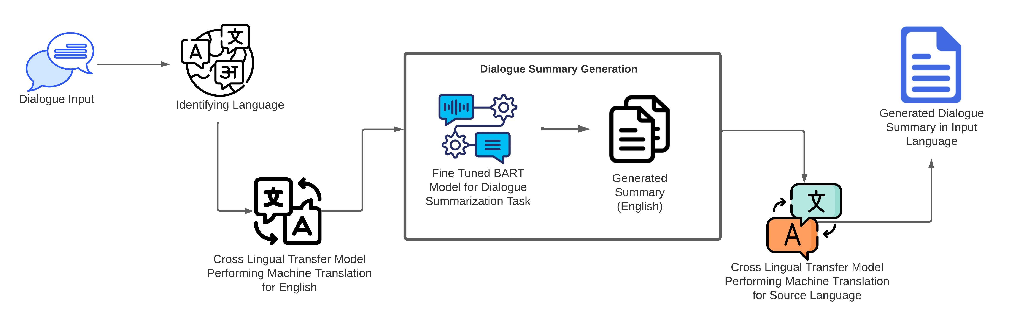
System Design
M2M100 Transformer
Many to many model.
Translate between multiple language.
Better language pattern recognition.
Bart-large-xsum Transformer
Backbone of this system.
Autoregressive and bidirectional capabilities.
Capture key information from the dialogue and convey the main points effectively.
Fine tuned on TWEETSUM dataset.

Slide 11
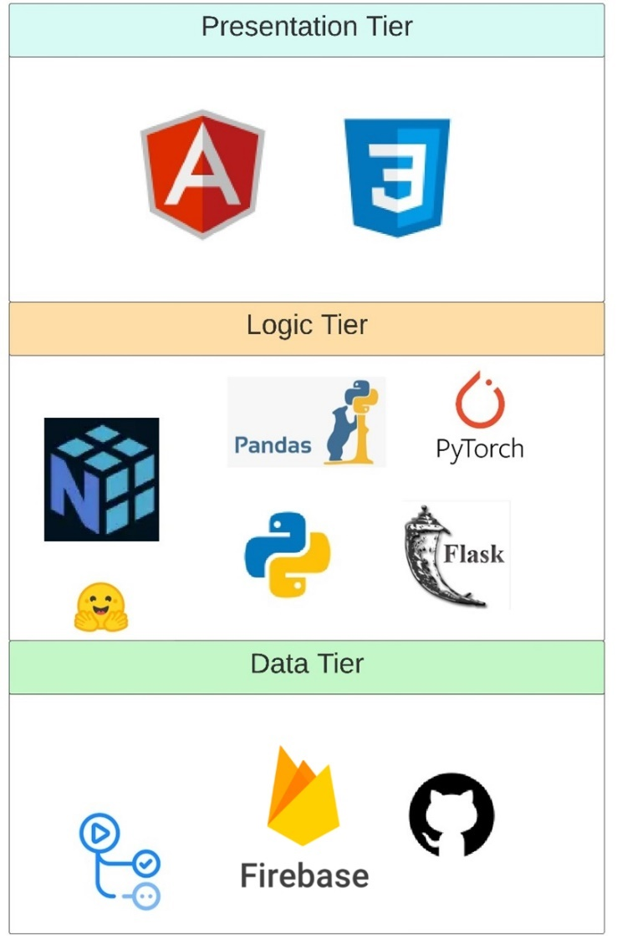
Implementation

Slide 12

Demo

Slide 13
Testing and Evaluation

Slide 14
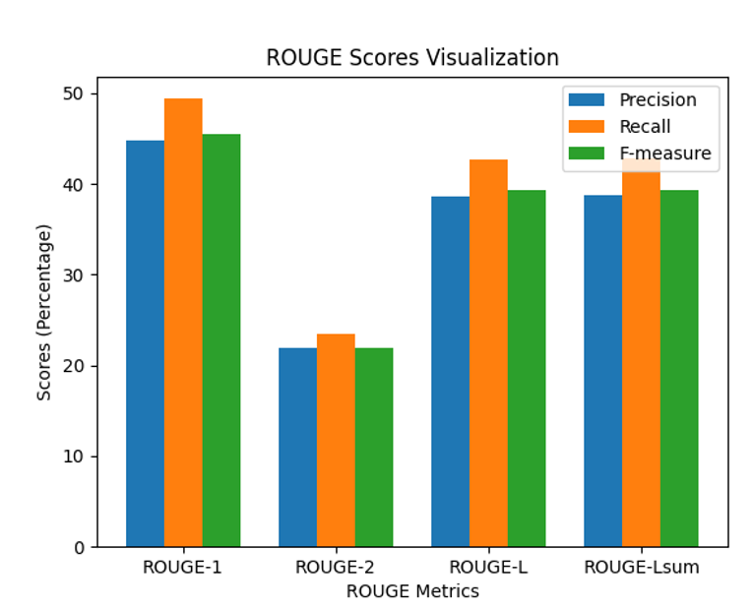
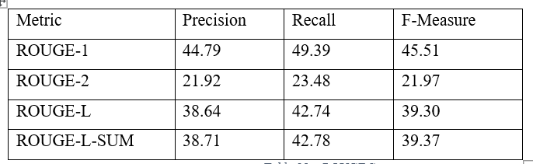
Testing and Evaluation - Metrices
Evaluated model generated summaries against ground truth summaries.
BERTScore | 0.6798

Slide 15


Testing and Evaluation – Human Evaluation
Social media platforms
Dedicated spaces for language learners
People fluent with language
Selection Criteria's
How was it carried out ?
Two examples were given
Dialogue – summary pairs
Rate on readability and truthfulness

Slide 16
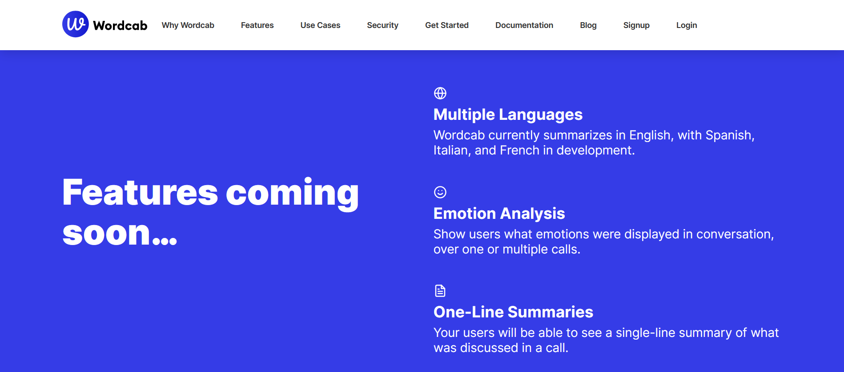
Existing Application Comparison
Ability to integrate with existing applications.
Not supported for multipole languages yet.

Slide 17
Limitation and Enhancement
Limitations
Cannot handle lengthy dialogues.
Performance on 97 languages supported by the translation model may vary.
Enhancements
Fine tune the machine translation modal with domain specific words, this will help to improve the translation process.
Explore alternative modals and architectures that can potentially improve the system’s summarization and translation process.

Slide 18
Conclusion - Contribution
Technical Contribution (Dialogue summarization)
Use of transformers and cross lingual transfer modals to develop a dialogue summarization solution which can support more than one language.
Use of existing text summarization modals for dialogue summarization tasks.
Domain Contribution (Customer Service)
A single tool capable of summarizing dialogues in more than one language.
Additional Contribution
By combining TWEETSUM and Kaggle customer care dataset into a new format, the proposed dataset format can be utilized to fine tune text summarization modal into dialogue summarization task.

Slide 19
Conclusion - Skills
Use of Existing Skills
NLP
Full stack development
New Skills Acquired
Dialogue Summarization Systems
Language Transformers
Knowledge on Cross Lingual Transformers

Slide 20
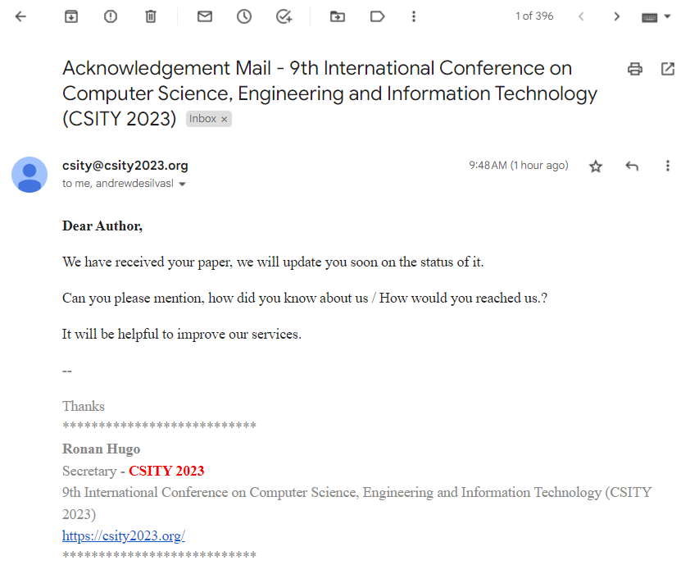
Conference
9th International Conference on Computer Science, Engineering and Information Technology (CSITY 2023)

Slide 21
References
Feng, Xiachong, Feng, Xiaocheng and Qin, B. (2022a). A Survey on Dialogue Summarization: Recent Advances and New Frontiers. Available from https://pypi.org/project/pyrouge/ [Accessed 29 October 2022].
Zou, Y., Zhu, B., et al. (2021). Low-Resource Dialogue Summarization with Domain-Agnostic Multi-Source Pretraining. Available from http://arxiv.org/abs/2109.04080 [Accessed 18 October 2022].

Slide 22
Thank You

